Slide 1
Health Awareness and Nutrition Vitamins
Department of Clinical Nutrition and Dietetics College of Health Sciences

Slide 2
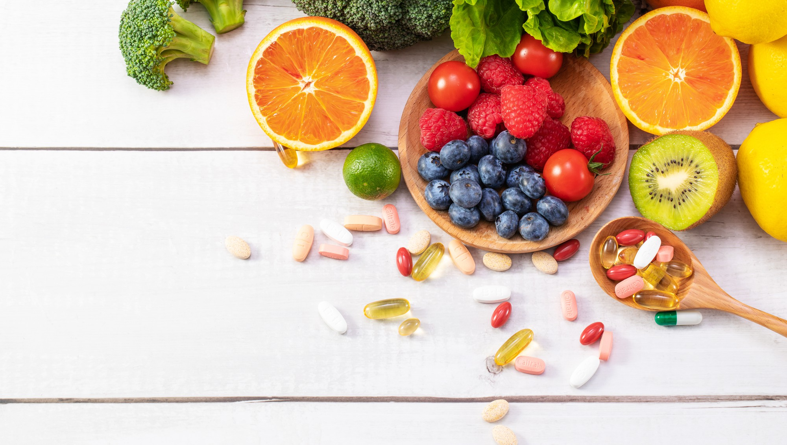
Vitamins

Slide 3
Characteristics of Vitamins
Vitamins are individual units as they are not linked together like carbohydrates or protein.
The amounts of vitamins people require are measured in micrograms (μg) or milligrams (mg).
Essential nutrients (Organic)
Vitamins don’t provide energy (Non-caloric)
Cannot be synthesized in sufficient quantities and must be obtained from the diet
They facilitate the chemical reactions that produce skin, bone, and muscle
Lack of one or more of vitamins, a person may develop a deficiency disease
Necessary for specific metabolic reactions and components of body tissue structure
Structure
Function
Food Contents

Slide 4


Classification of Vitamins
Vitamins are classified according to their solubility as:
Fat-soluble (liposoluble) vitamins
Water-soluble (hydro-soluble) vitamins
OIL
WATER
Vitamin A, D, E, K
4 Vitamins
B Vitamins, Vitamin C
9 Vitamins

Slide 5
Classification of Vitamins
Vitamins are classified according to their solubility as:
Fat-soluble (liposoluble) vitamins
→ Absorbed through the intestinal tract with the help of fats
→ Generally stored and accumulate in the body 🡪 become toxic in large doses
→ Symptoms of deficiency develop relatively late after their intake has been reduced
OIL
Water-soluble (hydro-soluble) vitamins
→ They are not stored in the body (are excreted in the urine)
→ Symptoms of deficiency develop early
→ Consistent (regular) intake is needed
WATER

Slide 6
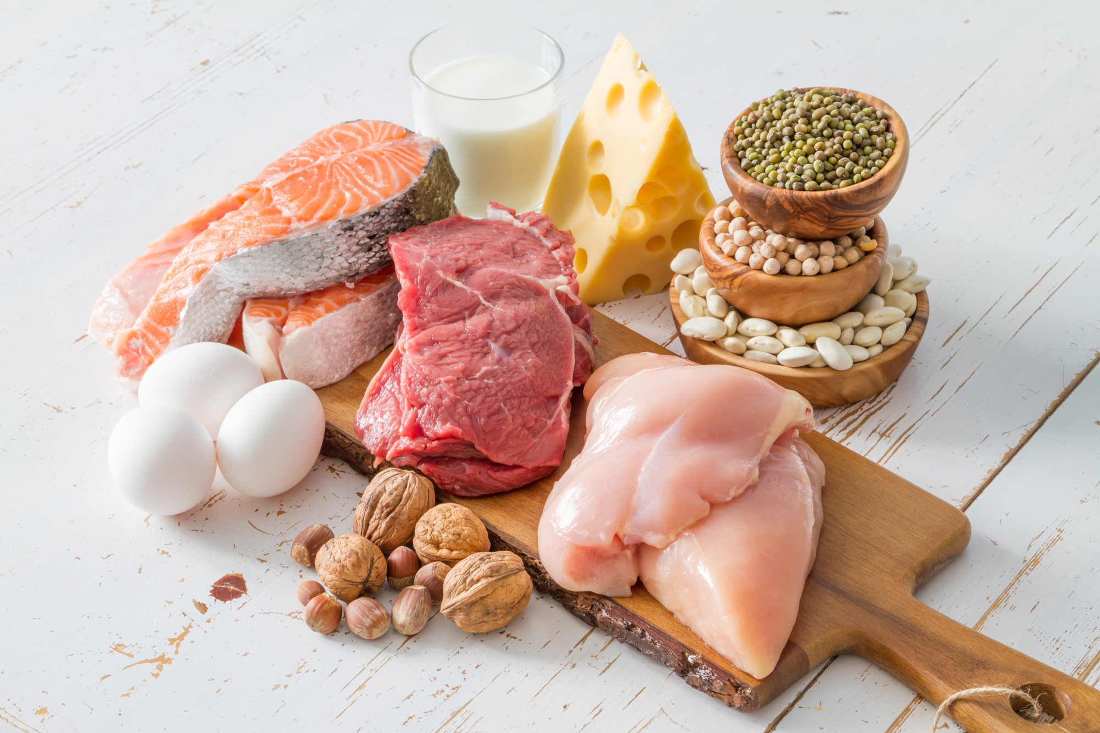
Fat-Soluble
Vitamins

Slide 7
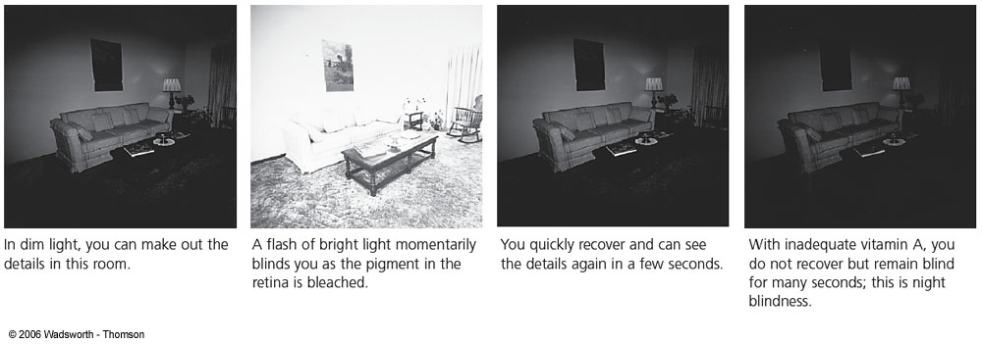
Vitamin A
Functions
Role in vision: Help in vision in dim light “night blindness”
Role in growth: Necessary for the development of skeletal and soft tissues
Role in maintenance of epithelia: Skin, cornea, mucous membranes
Reproduction: In women, Vitamin A supports normal fetal development during pregnancy.
In men, Vitamin A participates in sperm development. Children lacking Vitamin A fail to grow.
Immunity and Antioxidant (as beta-carotene): Protects the body against disease

Slide 8
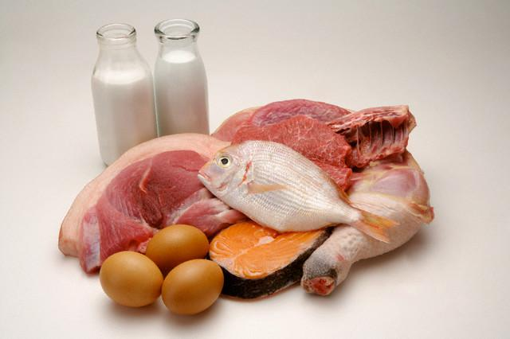
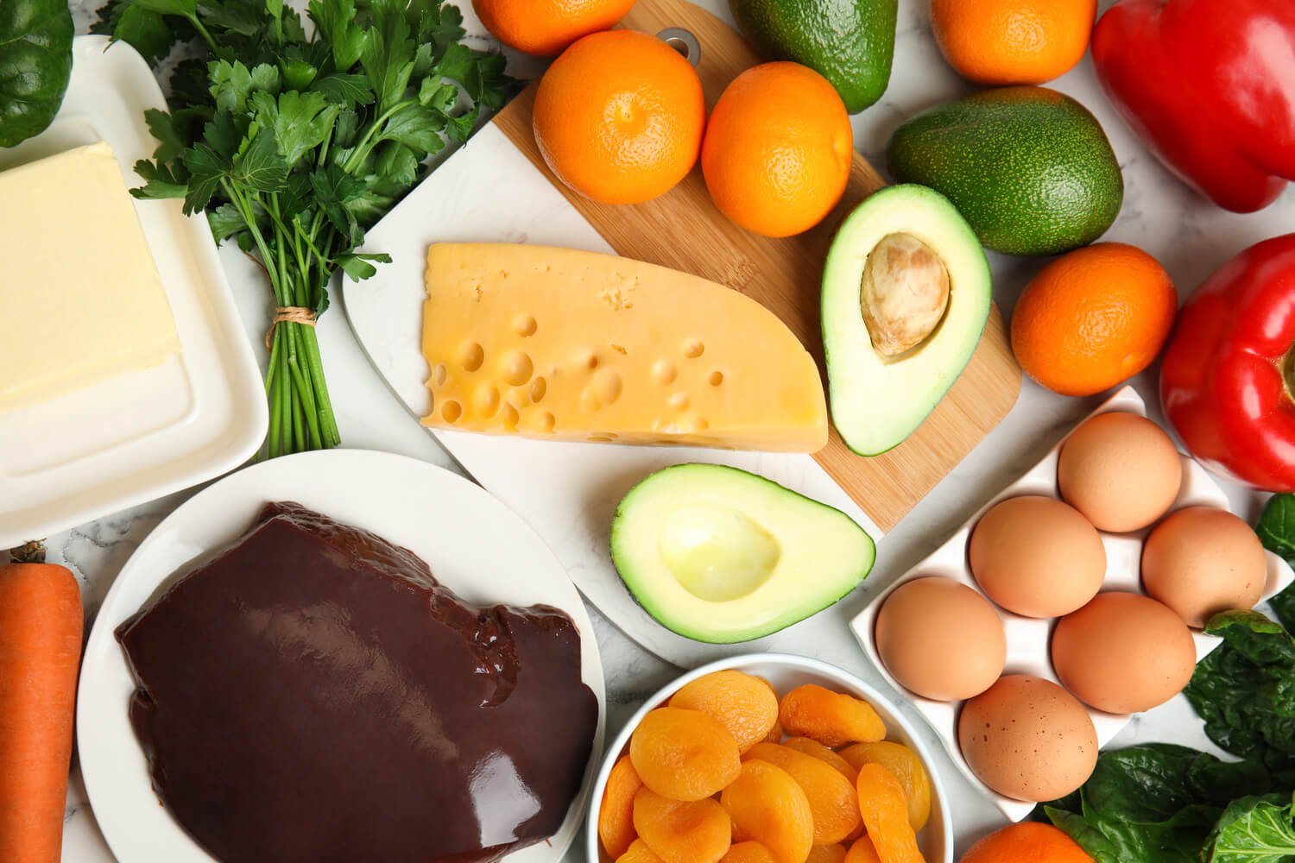
Vitamin A
Sources
→ Preformed Vitamin A (Retinol)
Animal food
Liver, fish, meat, eggs
Milk and milk products (cheese, cream, butter, fortified margarine)
→ Provitamin A (Beta-carotene)
Plant food
Orange-yellow-red- vegetables and fruits (carrots, apricots, sweet potatoes, pumpkin)
Dark green leafy vegetables (spinach, broccoli)

Slide 9
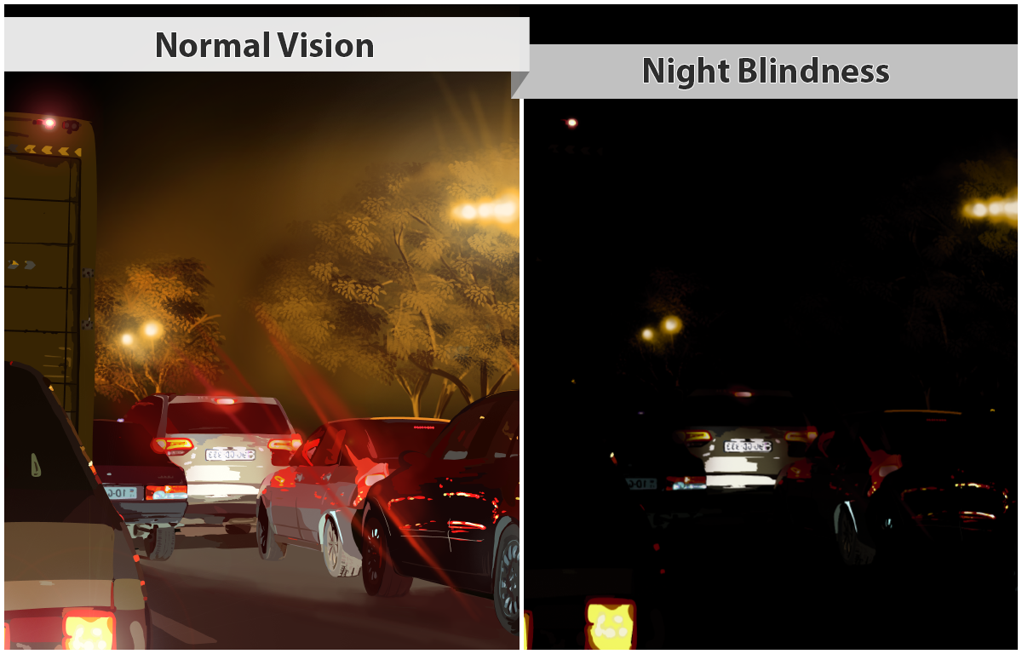
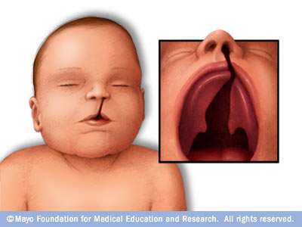
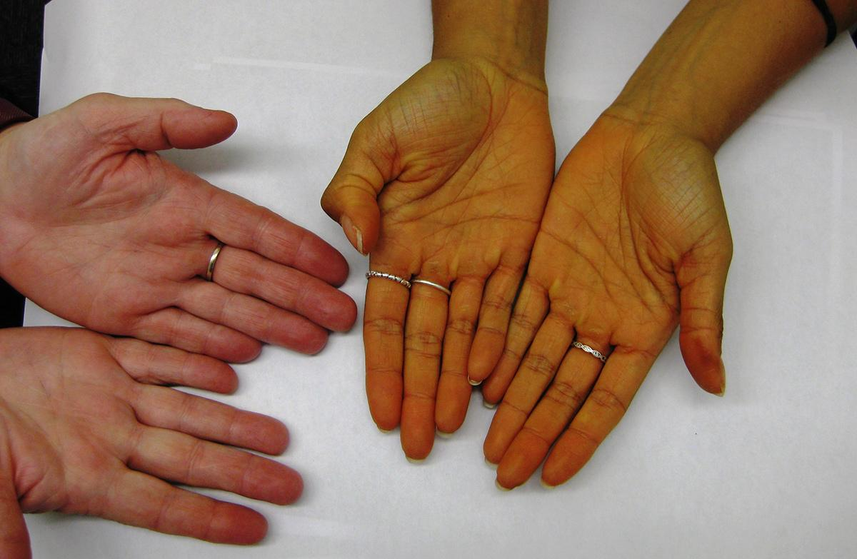
Vitamin A
Toxicity
Birth defects: excess of Vitamin A can cause toxicity in the newborn (cleft lip)
Excess of Beta-carotene causes harmless yellowing of the skin
Deficiency
Night blindness
Impaired immunity

Slide 10
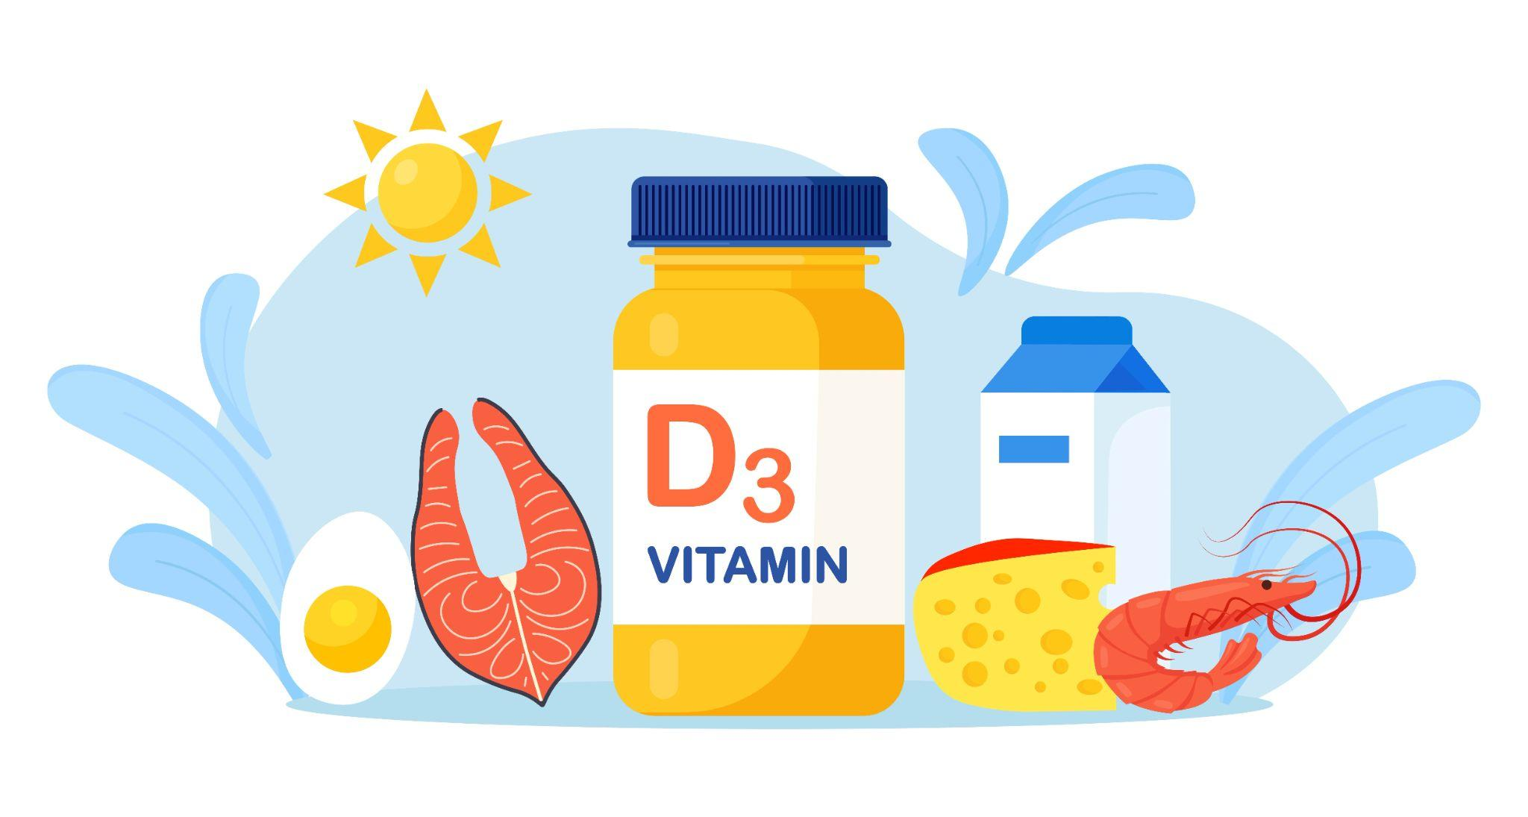
Vitamin D
Vitamin D helps regulate the amount of calcium and phosphate in the body.
These nutrients are needed to keep bones, teeth and muscles healthy.
Calcium, the primary component of bone, cannot be absorbed without the presence of Vitamin D.
The body produces vitamin D naturally when it’s directly exposed to sunlight.
Few foods naturally contain vitamin D.

Slide 11
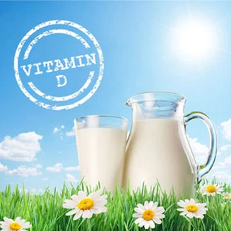
Vitamin D
Mineralization of bones: raises blood calcium and phosphorus by increasing absorption from the digestive tract, releasing calcium from the bones, and stimulating retention by the kidneys
Essential for calcium deposition in bones and teeth
Stimulates normal bone development
Permits normal skeletal growth
Functions

Slide 12

Vitamin D
Synthesized in the body under sunlight exposure
Richest food sources: fatty fish such as salmon and sardines (and their oils), egg yolks, liver
Vitamin D fortified sources: fortified milk, margarine, butter, and cereals
Sources

Slide 13


Vitamin D
Factors that contribute to deficiency:
A deficiency in vitamin D can result from inadequate exposure to sunlight, inefficient production in the skin, not enough vitamin D in your diet, or darker skin (the higher the levels of melanin pigment, the less UV rays are absorbed and the less vitamin D will be synthesized).
Deficient calcium deposition bone malformation or deterioration.
Deficiency
Notes:
Osteomalacia is the demineralization of the bones

Slide 14
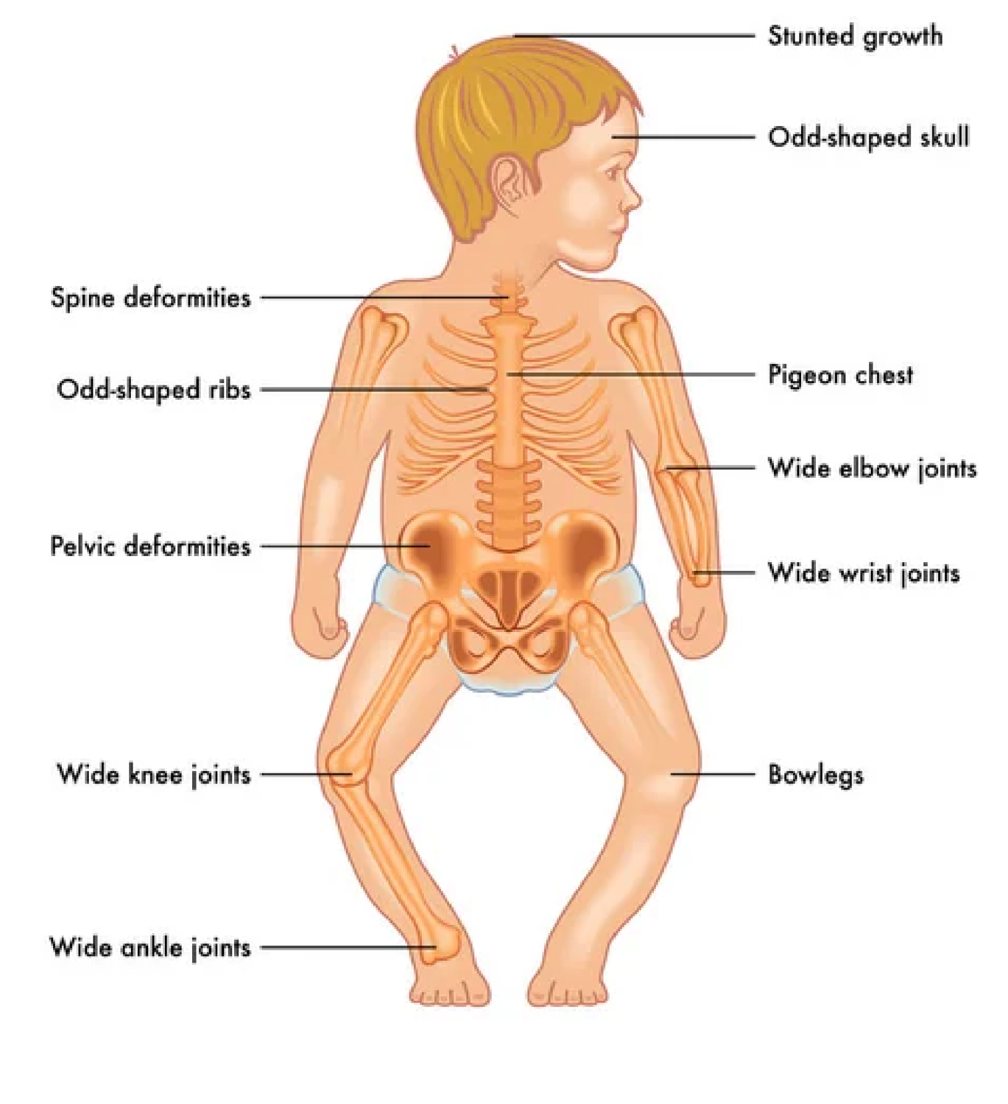
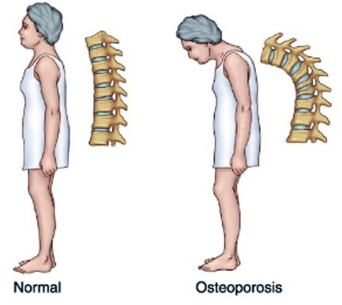
Vitamin D
In children – Rickets
Characterized by poor developed bones (bowed legs)
In adults – Osteomalacia
Loss of calcium
Soft, flexible, brittle, and deformed bones and bending of spine
Progressive weakness and pain in lower back and legs
Deficiency
Notes:
Osteomalacia is the demineralization of the bones

Slide 15








Osteoporosis
Risk factors
It is a disease of bones that leads to an increased risk of fractures caused by severe Vitamin D deficiency.
It is characterized by the loss of the bone mineral density (BMD) making them fragile (weak & delicate) and more likely to break.
Family history
Certain medications: hormone therapy (steroids)
Gender: more common in women
Body weight: underweight and obesity
Age: risk increases with age
Poor lifestyle habits: smoking, alcohol, caffeine
Nutrient deficiencies: Calcium and Vitamin D
Sedentary lifestyle

Slide 16
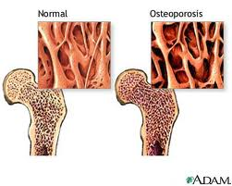

Osteoporosis
Symptoms
May cause no symptoms initially
Later, it may cause dull pain in the bones or muscles, particularly in lower back or neck
Later in the course of the disease, sharp pains may come on suddenly
Anyone “at risk" for osteoporosis should have their bone density checked
A Bone Density Test (Densitometry) can be performed for patients who may have osteoporosis
Bone Density Tests are also useful to monitor the progression of osteoporosis and the response to treatments
Diagnosis

Slide 17



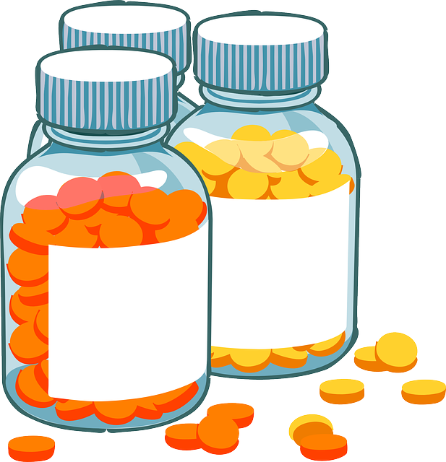

Osteoporosis
Prevention
Exercise and lifestyle: walking or aerobics and light weight bearing
A diet containing all the nutrients in optimum amounts plus calcium supplements may be taken on prescription along with vitamin D if someone’s dietary intake is low and absorption is poor.
Exercise: Walking and light aerobics and avoid heavy training
Eat foods that are high in calcium: dairy products, dark green leafy vegetables, nuts, dried fruits, fish, tofu
Supplements: Take calcium and Vitamin D supplements
Stop smoking and alcohol intake

Slide 18
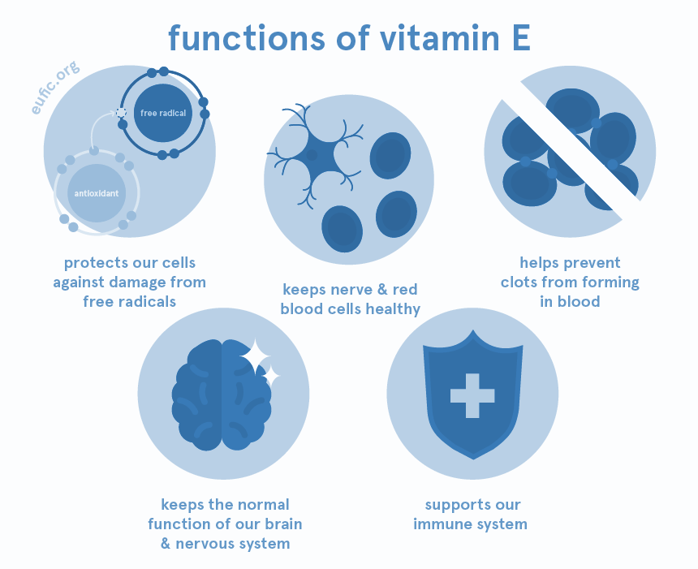
Vitamin E
Anti-sterility: Helps in reproduction
Antioxidant (along with Vitamin A and C):
Stabilization of cell membranes
Regulation of oxidation reactions
Functions

Slide 19

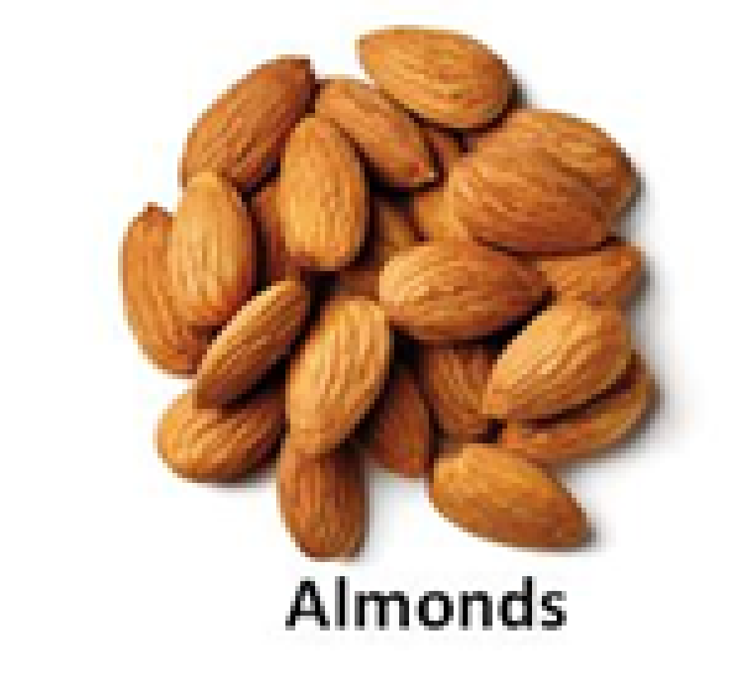
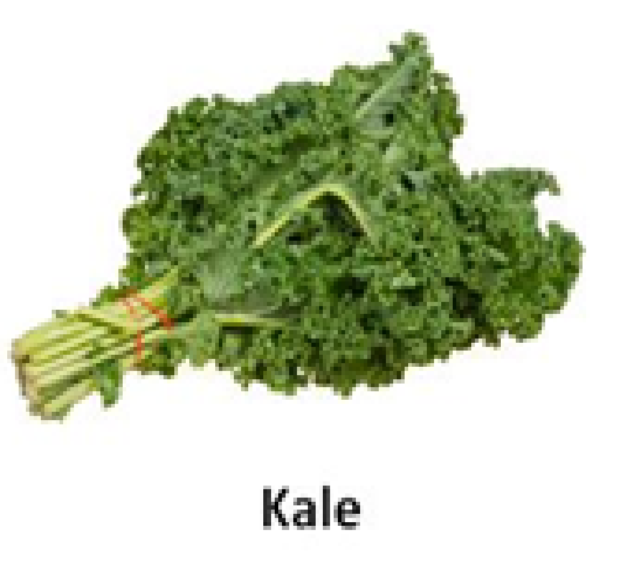
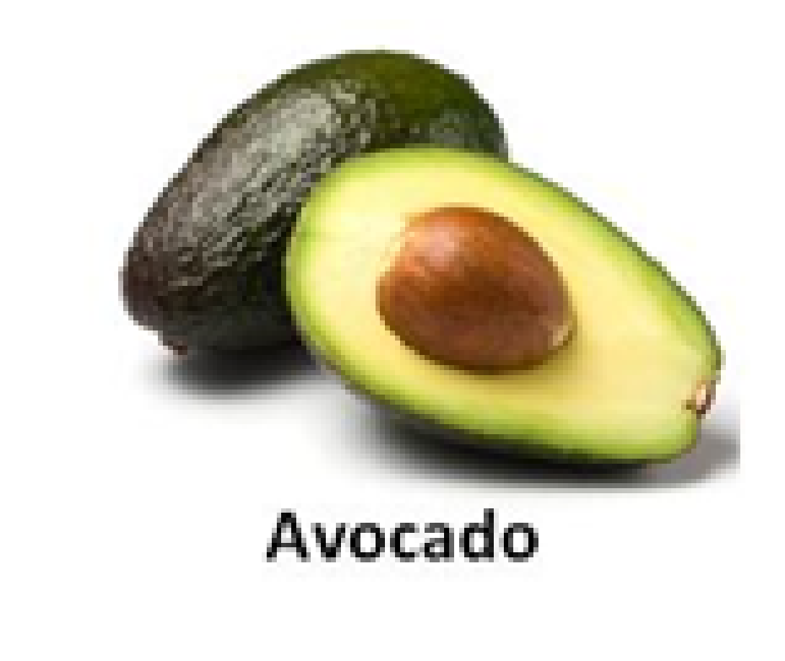
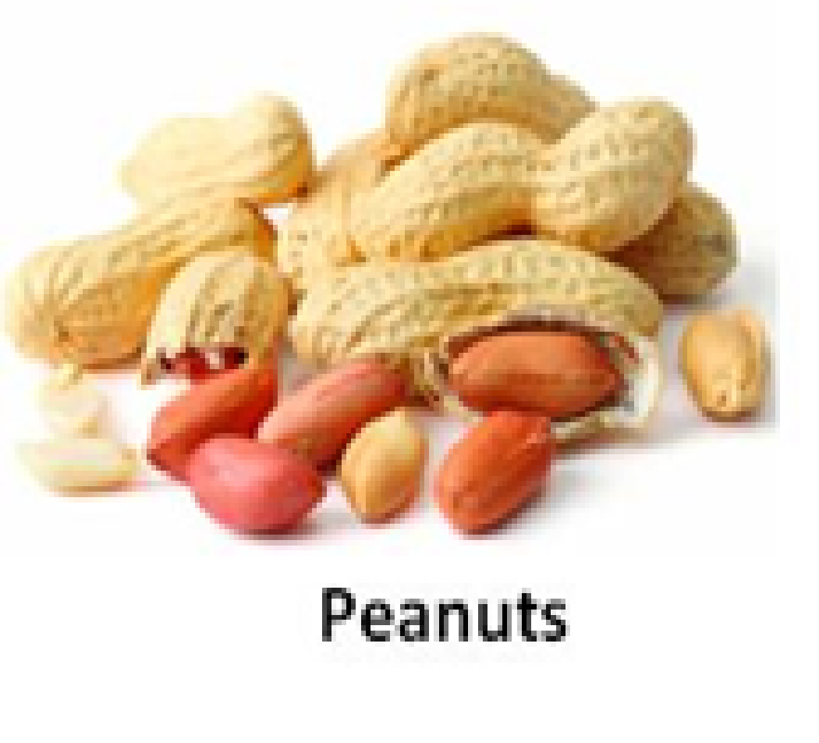
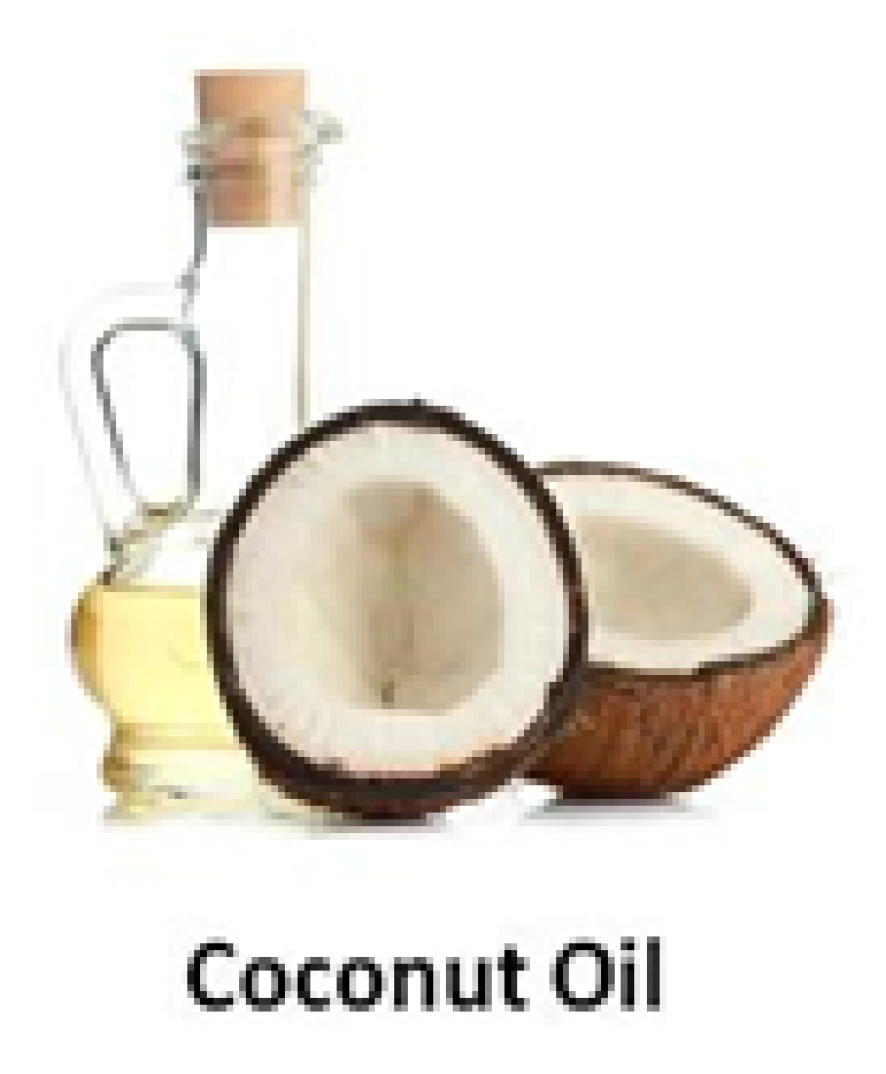
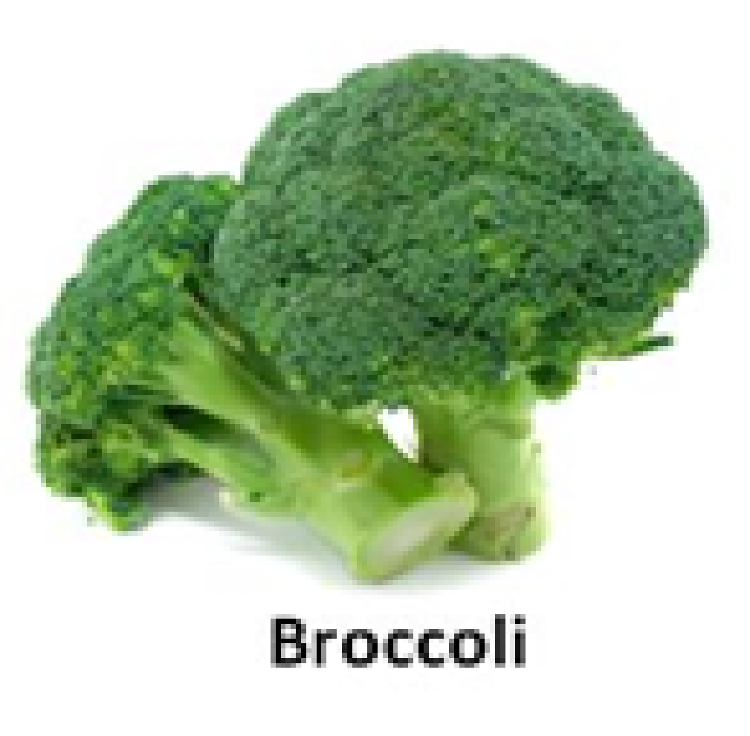
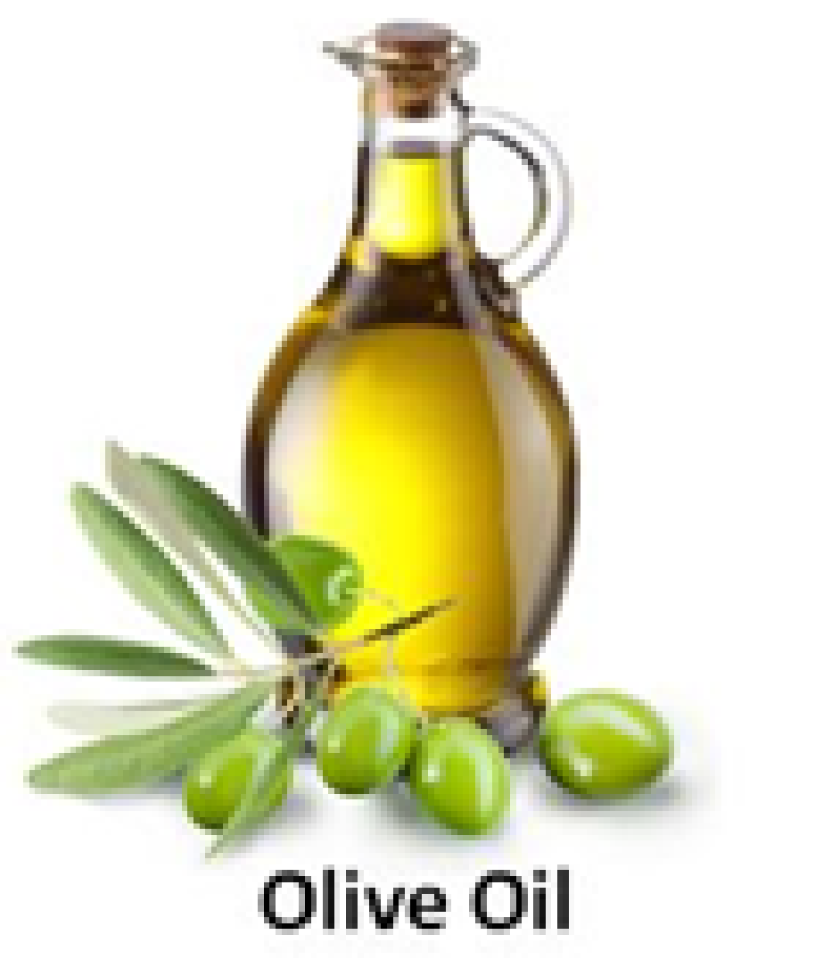
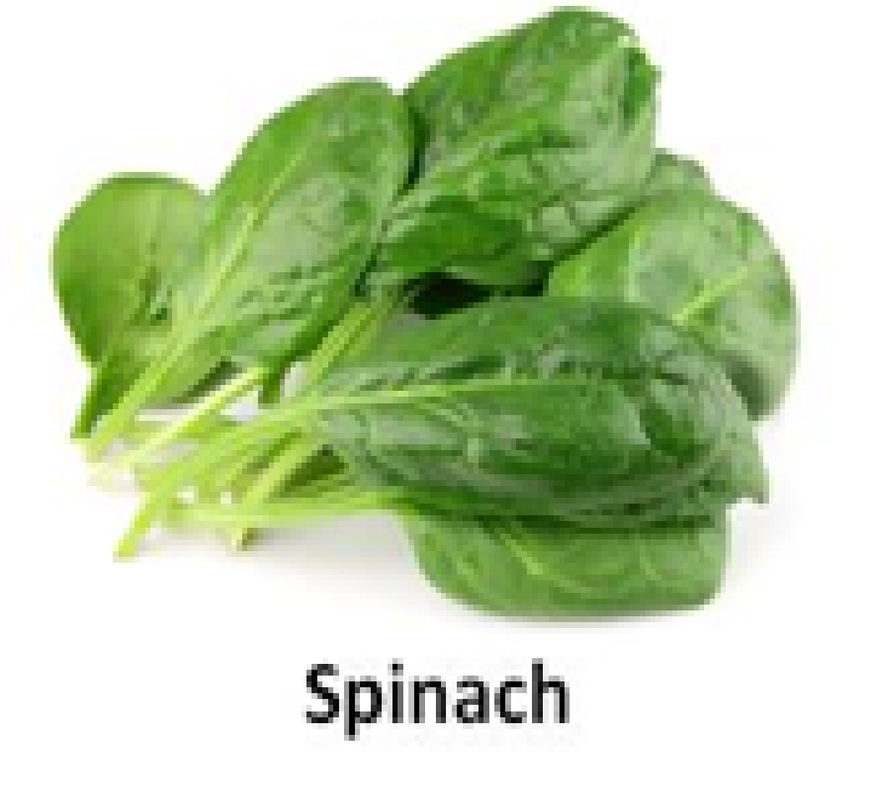
Vitamin E
Vitamin E is widespread in food, making it difficult to create a vitamin E-deficient diet
It can be easily destroyed by heat and oxygen
Best sources: plant seed oils such as soybean, sunflower, corn oil, nuts, olives, green leafy vegetables
Sources

Slide 20
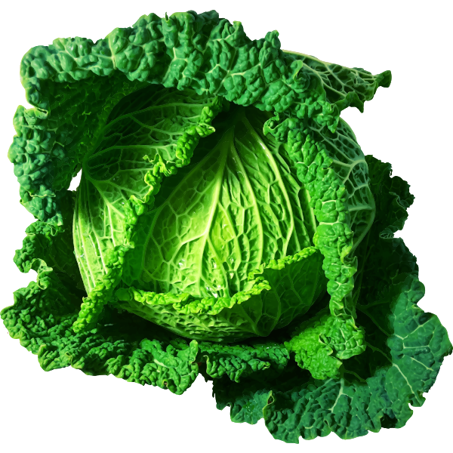
Vitamin K
Blood coagulation: necessary for the formation of blood clotting proteins
Best sources: green leafy vegetables (spinach, lettuce, broccoli and other members of the cabbage family)
Non-dietary source: Significant amounts produced by intestinal bacteria
Functions
Sources

Slide 21
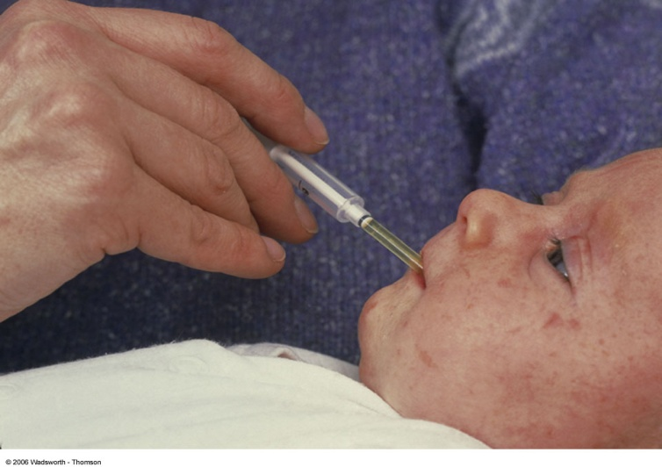
Vitamin K
Vitamin K deficiency results in hemorrhage
Unlikely in adults.
At Risk: Newborns who fail to establish intestinal bacteria that produce Vitamin K
At birth newborns are given a dose of Vitamin K to hold them until vitamin K-producing bacteria establish themselves in their intestinal tract
Deficiency

Slide 22
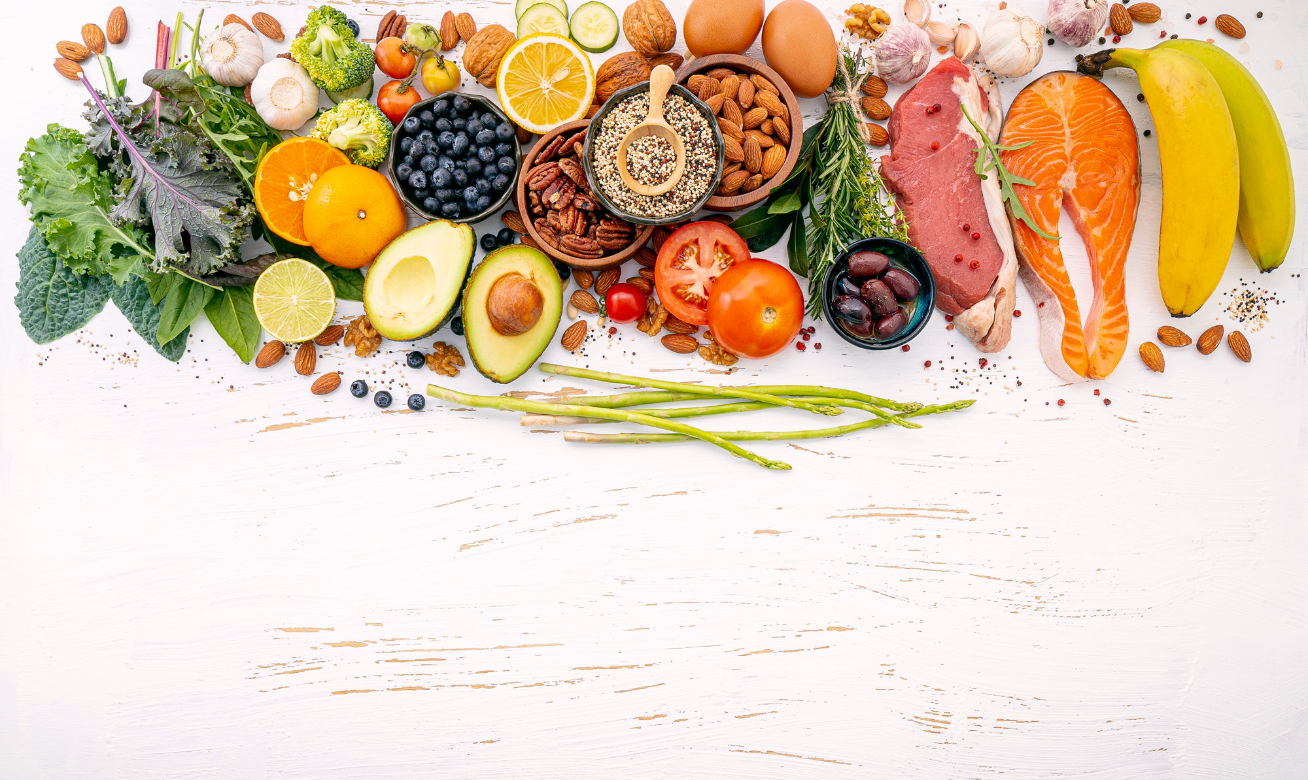
Water-Soluble Vitamins

Slide 23
Water-Soluble Vitamins
General function:
The B and C vitamins help enzymes in their function: are cofactors in enzymatic reactions
Involved in energy (Adenosine triphosphate-ATP) production reactions: ATP is able to store and transport chemical energy within cells.
9 Water-soluble Vitamins
Vitamin B₁ (Thiamine)
Vitamin B₂ (Riboflavin)
Vitamin B₃ (Niacin)
Vitamin B₅ (Pantothenic acid)
Vitamin B₆ (Pyridoxine)
Vitamin B₇ (Biotin)
Vitamin B₉ (Folic acid)
Vitamin B₁₂ (Cobalamin)
Vitamin C (ascorbic acid)

Slide 24
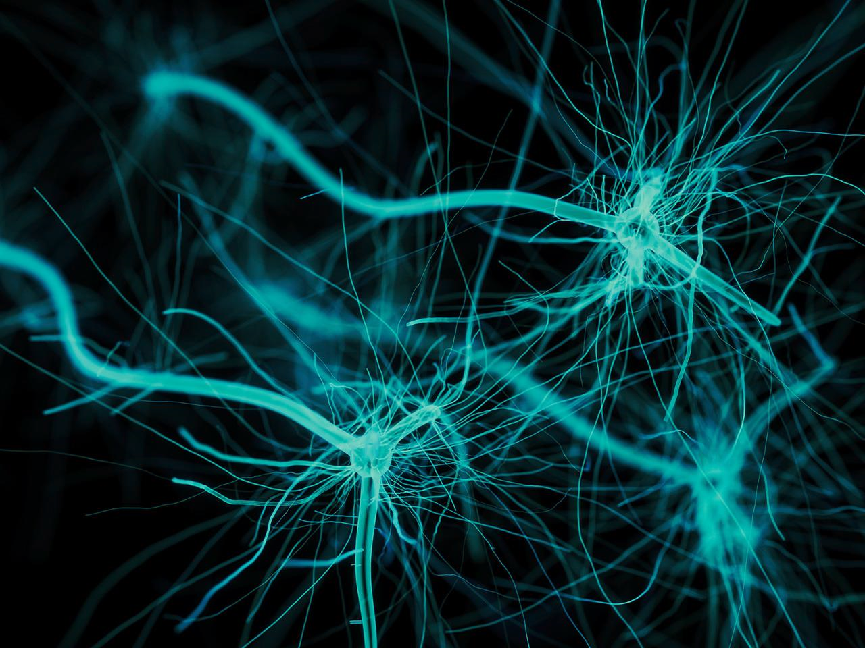
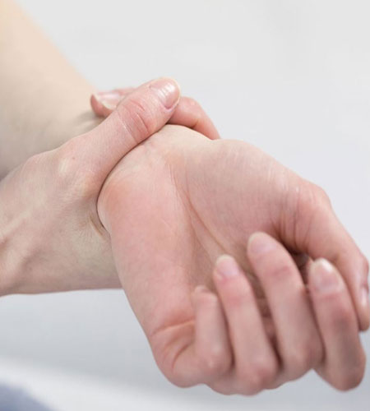
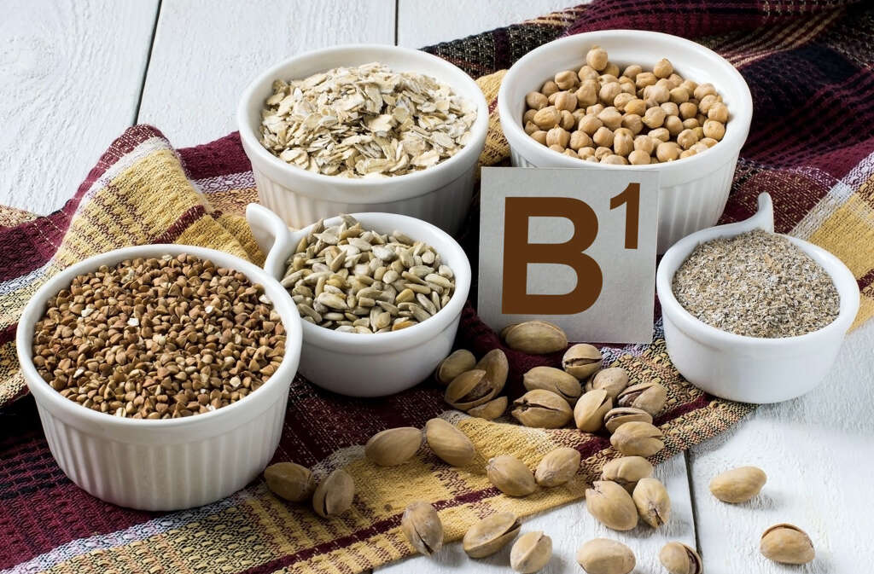
Thiamin (B1)
It is needed as a coenzyme for energy metabolism
Proper function of the nervous system
Whole grains, nuts
Found in a lot of foods
Not very common nowadays
Beriberi: weakness in nerves
Functions
Sources
Deficiency

Slide 25
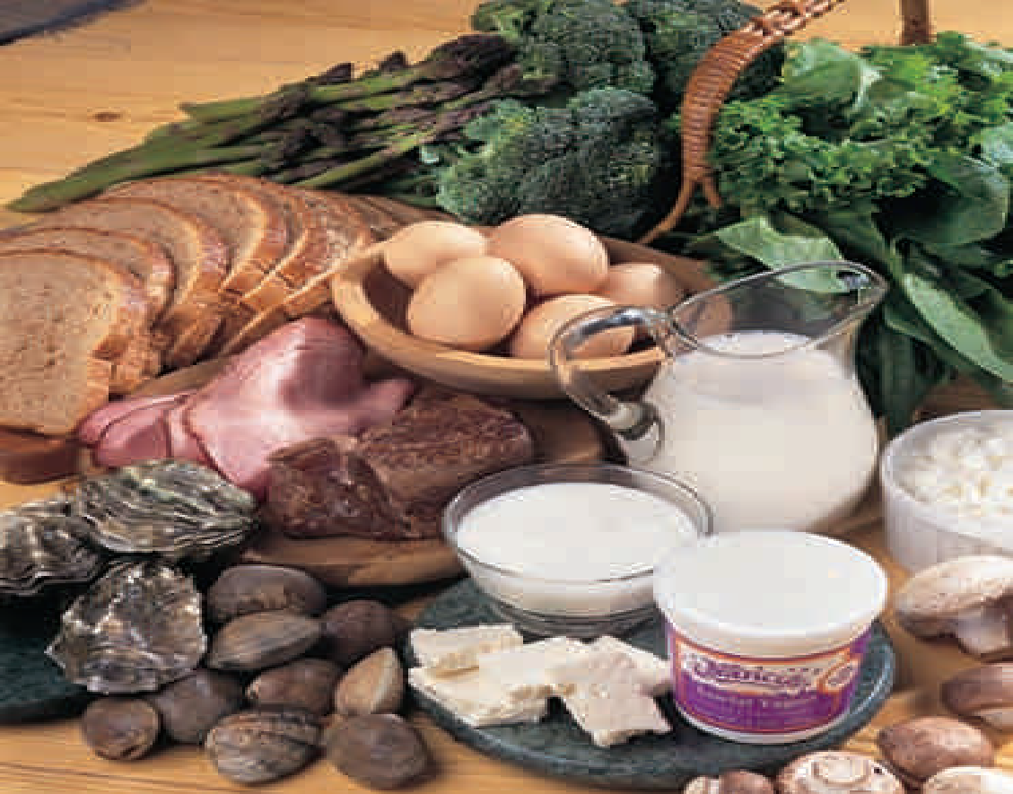
Riboflavin (B2)
It is needed as a coenzyme for energy metabolism
Maintain integrity of epithelial & mucosal linings
Milk products (yogurt, cheese)
Whole grains
Liver, eggs, green leafy vegetables
Functions
Sources

Slide 26
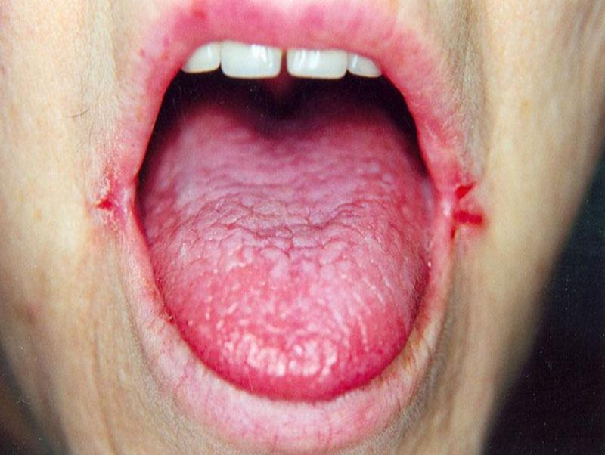
Riboflavin (B2)
Ariboflavinosis: (dryness & cracking of lips)
Cracks and redness at corners of mouth
Painful, smooth, purplish red tongue
Deficiency

Slide 27
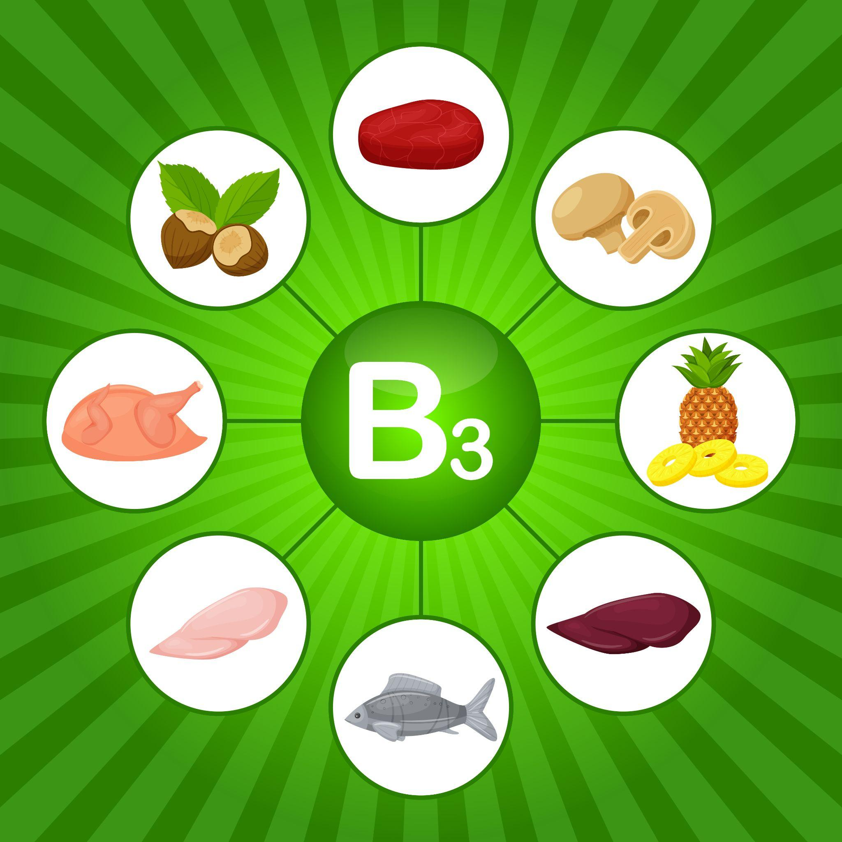
Niacin (B3)
It is needed as a coenzyme for energy metabolism
Proper function of the digestive and nervous systems
Milk, meat, poultry, fish
Whole-grains and legumes, liver, eggs, nuts
Pellagra: diarrhea, dryness of skin, memory loss
3 Ds of Pellagra: are diarrhea, dermatitis, dementia and if untreated- death
Functions
Sources
Deficiency

Slide 28
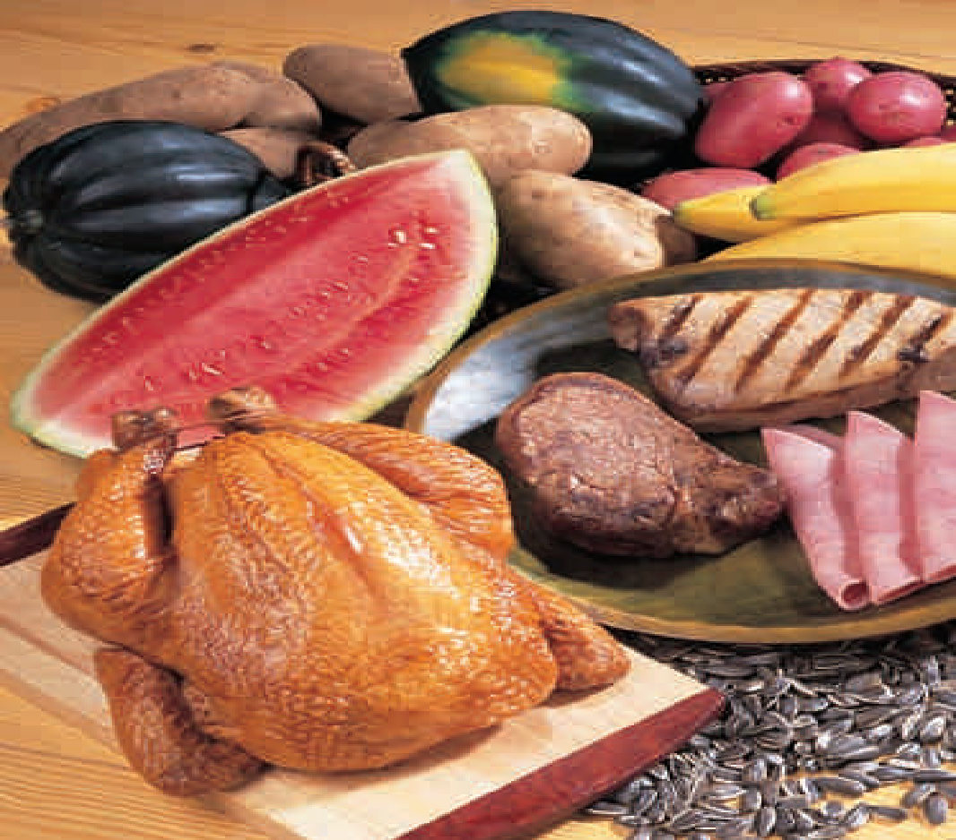
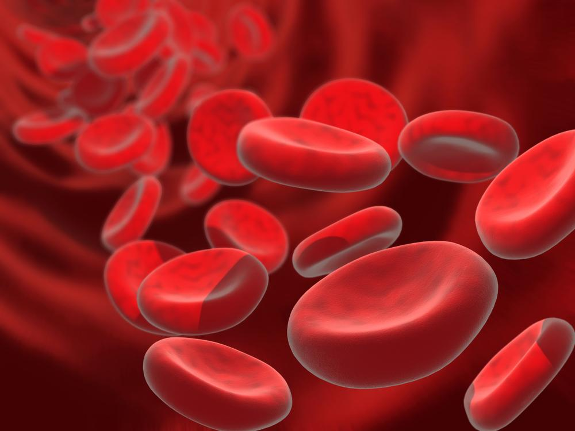
Pyridoxine (B6)
It is needed as a coenzyme for energy metabolism
Helps the process of producing red blood cells
Milk, meat, poultry, fish, liver
Potatoes and starchy vegetables and legumes
Non-citric fruits
Dermatitis
Anemia (microcytic anemia)
Depression and confusion
Functions
Sources
Deficiency

Slide 29
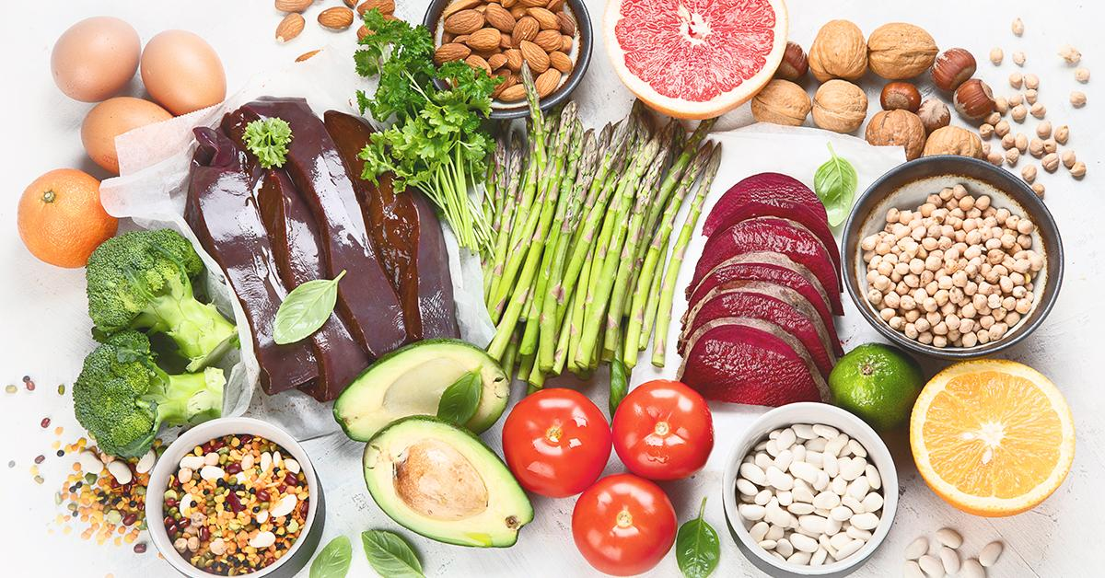
Folic Acid (B9)
It is needed as coenzyme for energy metabolism
Normal development of red blood cells in the bone marrow
Help synthesize DNA especially for the fetus
Green leafy vegetables, fruits, legumes, whole grains, organ meats, liver, eggs
Functions
Sources

Slide 30
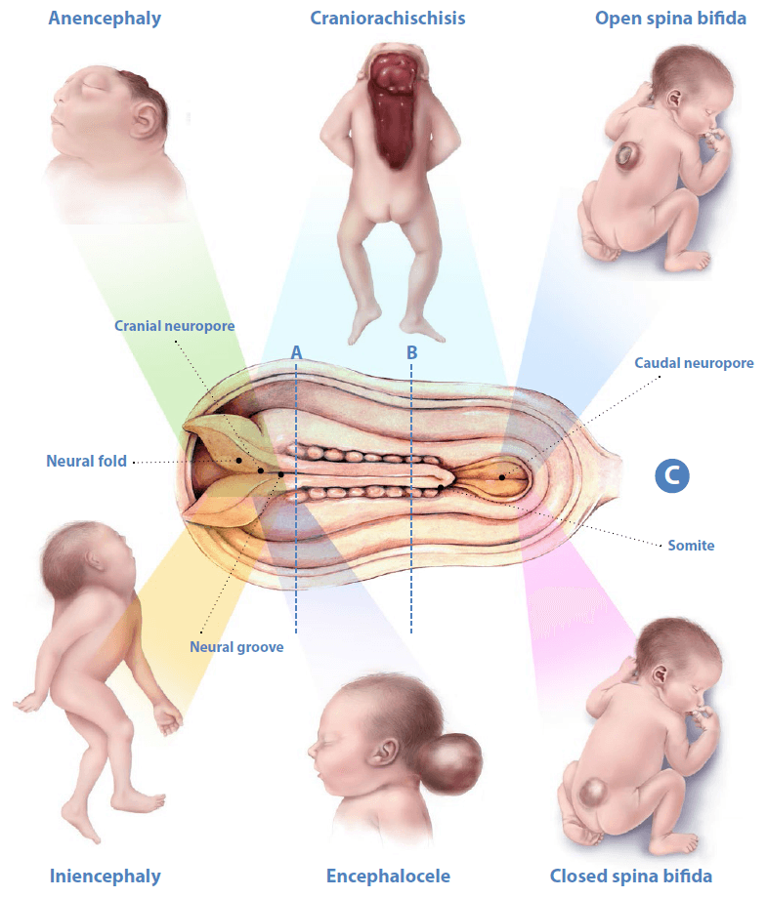
Folic Acid (B9)
Birth defect (neural tube defects): brain, spine, or spinal cord defects
Megaloblastic anemia: poor development of blood cells, particularly during pregnancy
Deficiency

Slide 31
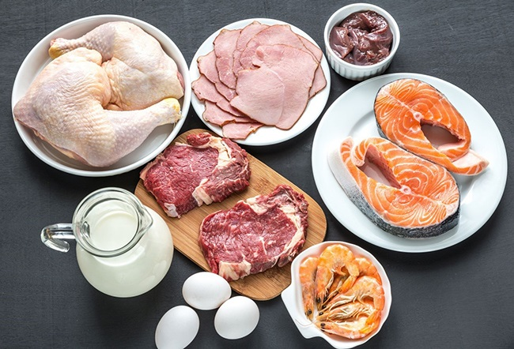
Cobalamin (B12)
It is needed as a coenzyme for energy metabolism
Works with folic acid to form red blood cells
It is important for normal functioning of nerve tissue
Only found in food from animal source: Meat, fish, liver, poultry, milk, cheese, eggs
Strict vegetarians→ need supplements of Vitamin B12
Easily destroyed by microwave cooking.
Functions
Sources

Slide 32
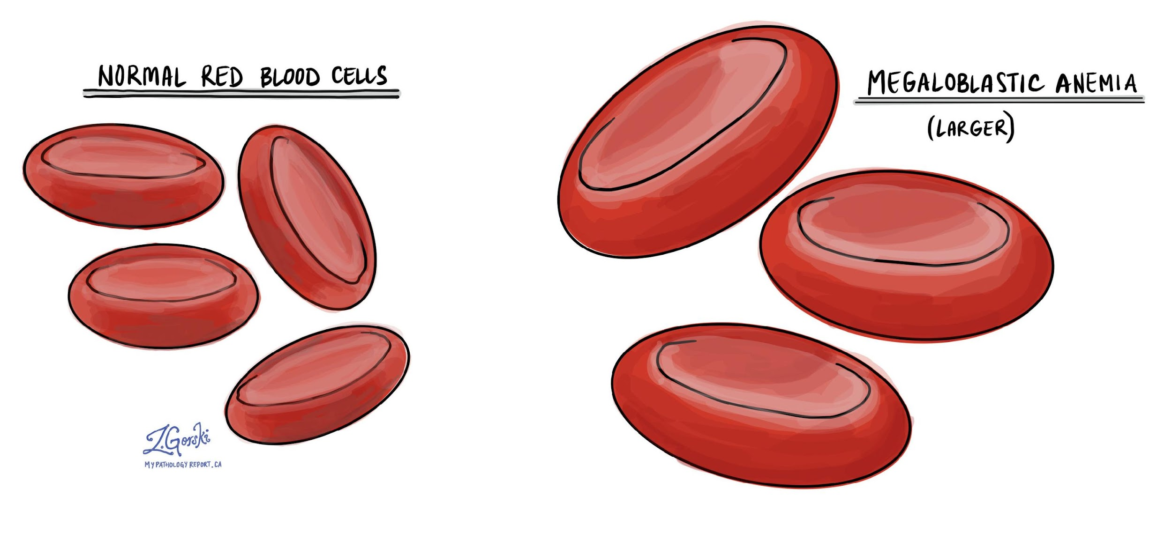
Cobalamin (B12)
Deficiency may cause megaloblastic anemia, particularly during pregnancy
Fatigue is another symptom of deficiency
Deficiency

Slide 33

Ascorbic Acid (Vitamin C)
Involved in collagen synthesis (protein in bones, cartilage, skin) → important in healing of fractures and wounds
Strengthens the immune system
Increases resistance to cold and infections
Stimulates iron absorption from plant sources
Antioxidant
Functions

Slide 34

Ascorbic Acid (Vitamin C)
Fresh fruits and vegetables (esp. if acidic)
Processed and cooked foods are poor sources
Attention:
Can be easily destroyed by heat and upon exposure to air (oxidation)
Content decreases during storage and if peeled or cut
Sources

Slide 35
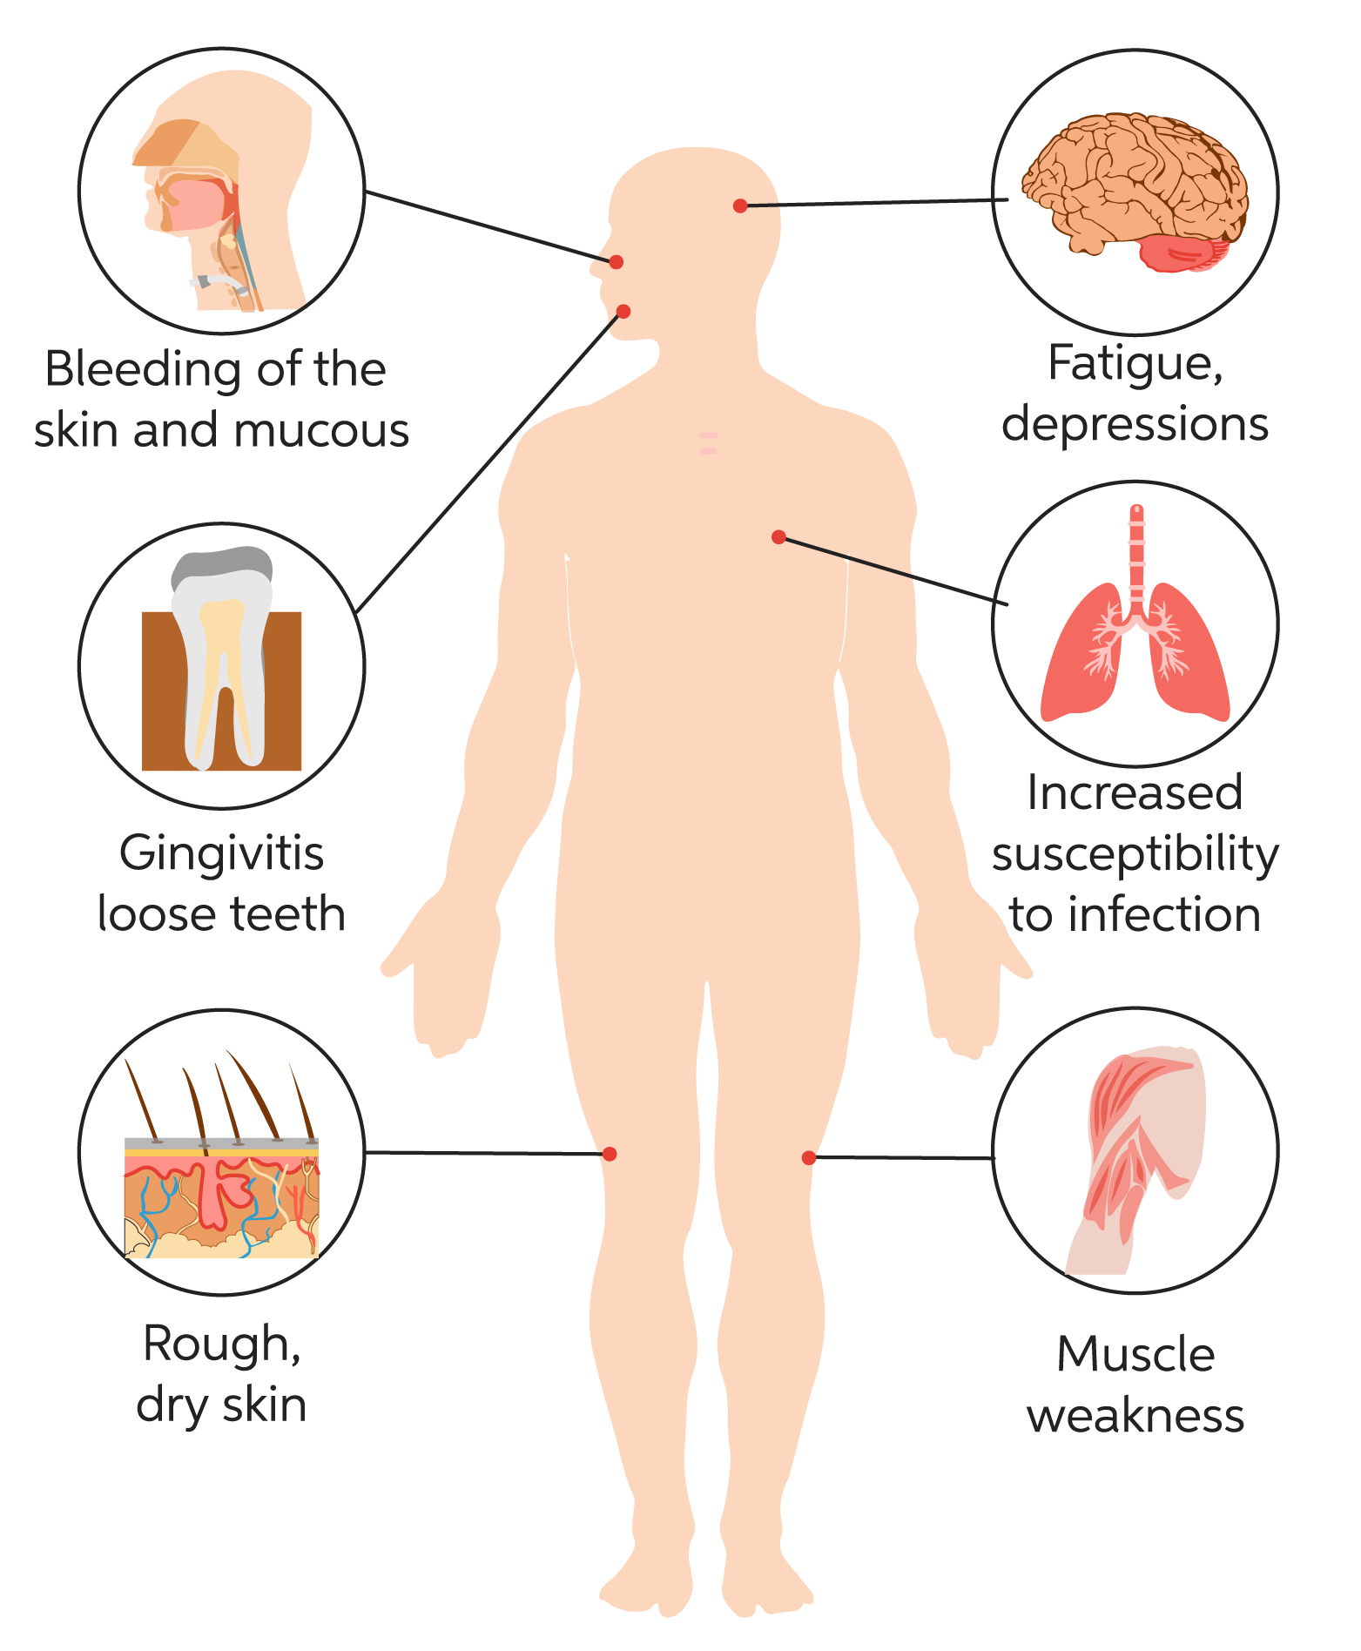
Ascorbic Acid (Vitamin C)
Scurvy
Symptoms include:
Swollen and inflamed gums
Loose teeth
Dryness of eyes and mouth
Dry itchy skin, hair loss
Defect in wound healing
Frequent infections
Deficiency

Slide 36
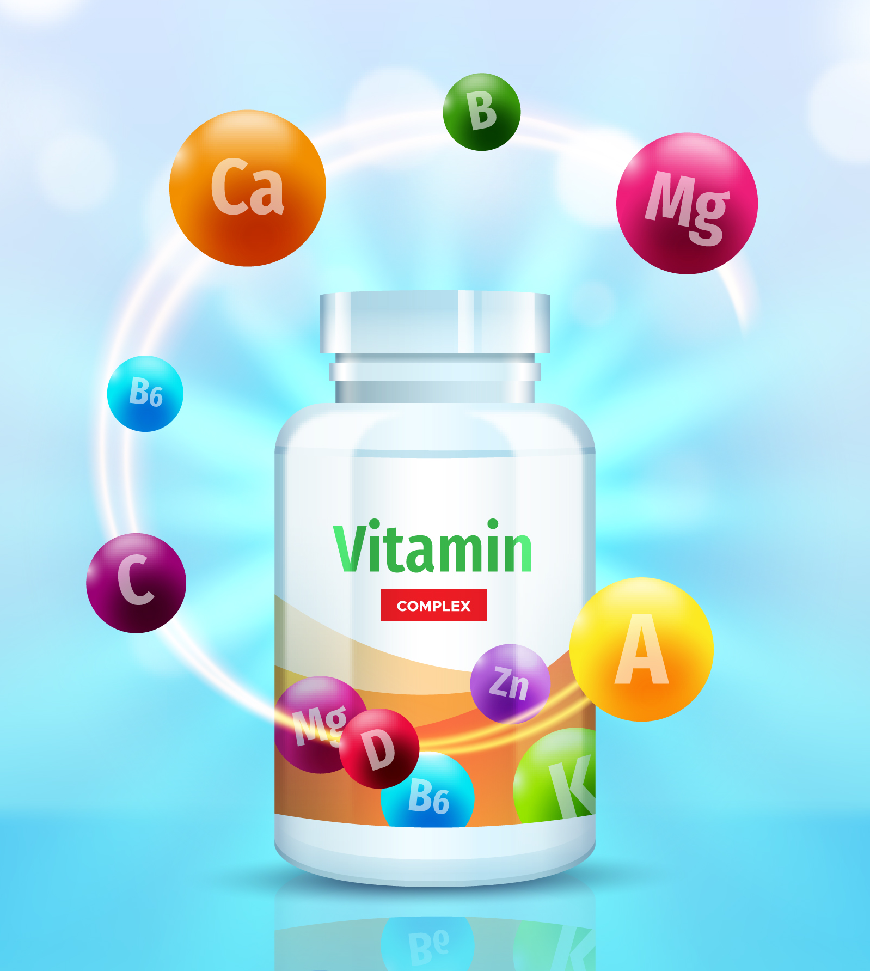
Vitamin Supplementation
Nearly 40% of the U.S. population take a vitamin supplement.
People who may benefit from vitamin supplements include:
People with vitamin deficiency
Women in childbearing years
Pregnant and lactating women
People who diet a lot
Elderly people
Those recovering from surgery, injury
Strict vegetarians (vitamin B12)

Slide 37

Vitamin Supplementation
Supplements may be risky if taken…
By people to feel secure about getting enough nutrients
By people who have conditions that increase vitamin toxicity (kidney or liver disease)
To get energy when feeling tired
To cope with stress
To build muscles faster
To prevent/cure self-diagnosed conditions

Slide 38

Information For
Your Interest

Slide 39
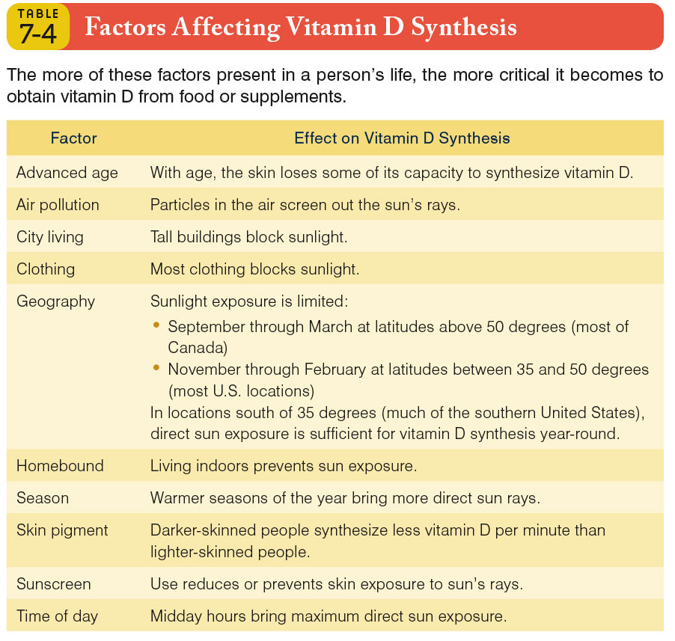
Factors Affecting Vitamin D Synthesis

Slide 40
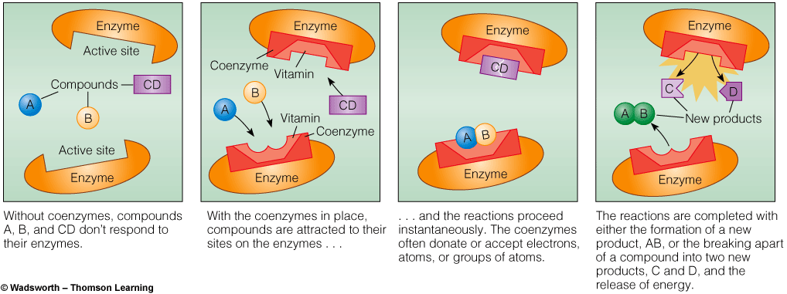
Water Soluble Vitamins
Coenzymes

Slide 41
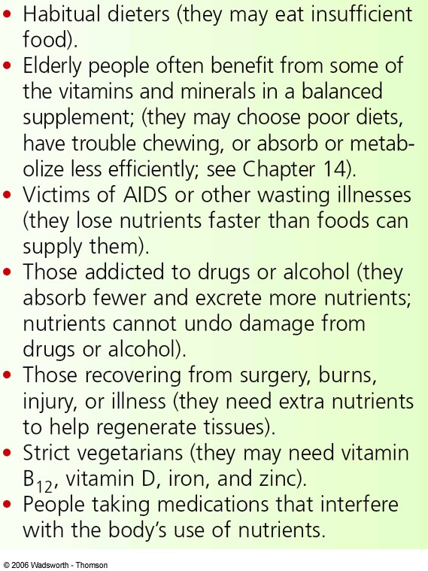
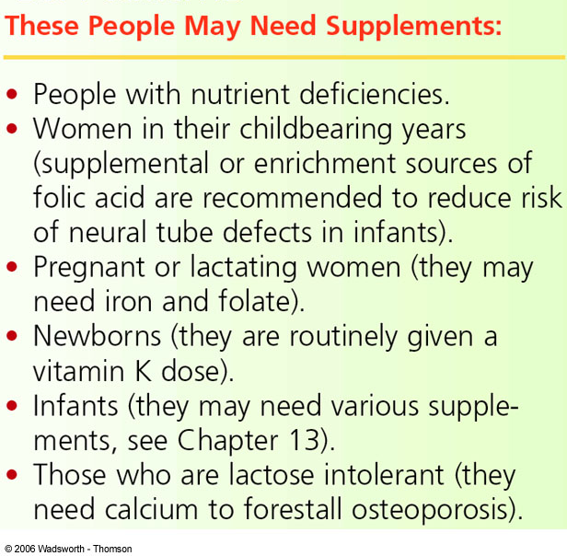
Some Valid Reasons for Taking Supplements

